Slide 1


Jayathilaga Ramajayam
Analyst - Data Analytics, Verizon India
Runner up - AI/ML hackathon conducted by Techgig Geek Goddess 2019
https://www.linkedin.com/in/jayathilaga-ramajayam-1a037792

Slide 2
Step by Step process of building a ML Model

Slide 3


What is Machine learning?
Machine learning is an application of artificial intelligence (AI) that provides systems the ability to automatically learn and improve from experience without being explicitly programmed.
Why use of Machine Learning model
The rule of thumb is: use Machine Learning when traditional programming methods can’t deal efficiently with the problem.
Notes:
Example - throwing paper
Recommendation - i/p, o/p, prog
“If a typical person can do a mental task with less than one second of thought, we can probably automate it using AI either now or in the near future.”— Andrew Ng

Slide 4
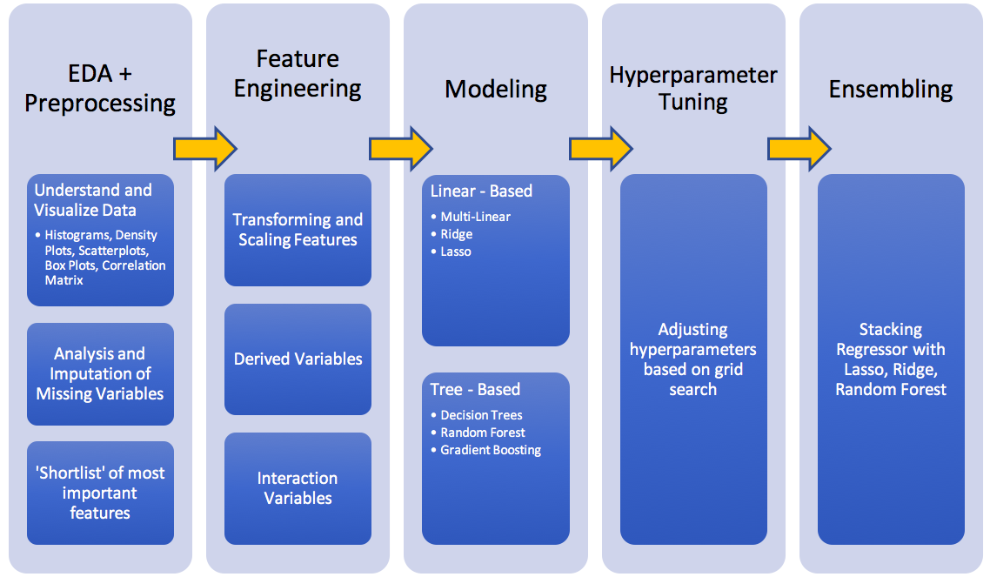
Step by step process in model building
Validation
Accuracy, precision, recall, F1 score

Slide 5
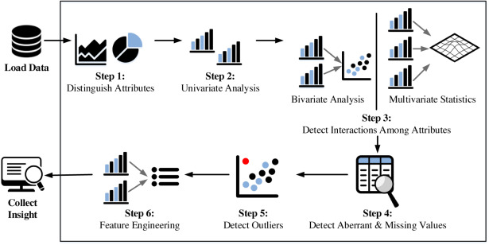
Exploratory Data Analysis
To gain a sense of the relationship of the features with each other and the target variable
Notes:
Continuously changes and no change

Slide 6
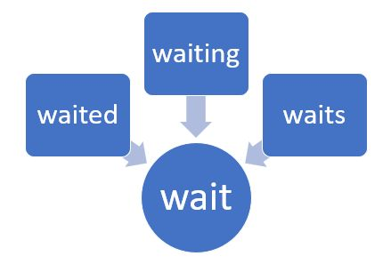
Data Preprocessing and Data cleaning
For Categorical and numerical data:
Handling Missing values,
Ignore the column
Fill the missing values
For textual data:
Lower case
Remove stop words
Remove punctuations
Stemming
Lemmatization

Slide 7
Feature Engineering
Preparing the proper input dataset, compatible with the machine learning algorithm requirements.
Imputation
Handling Outliers
Binning
Log Transform
One-Hot Encoding
Grouping Operations
Feature Split
Scaling
Extracting Date
According to a survey in Forbes, data scientists spend 80% of their time on data preparation
Notes:
“Hour_Of_Day”
Age range

Slide 8
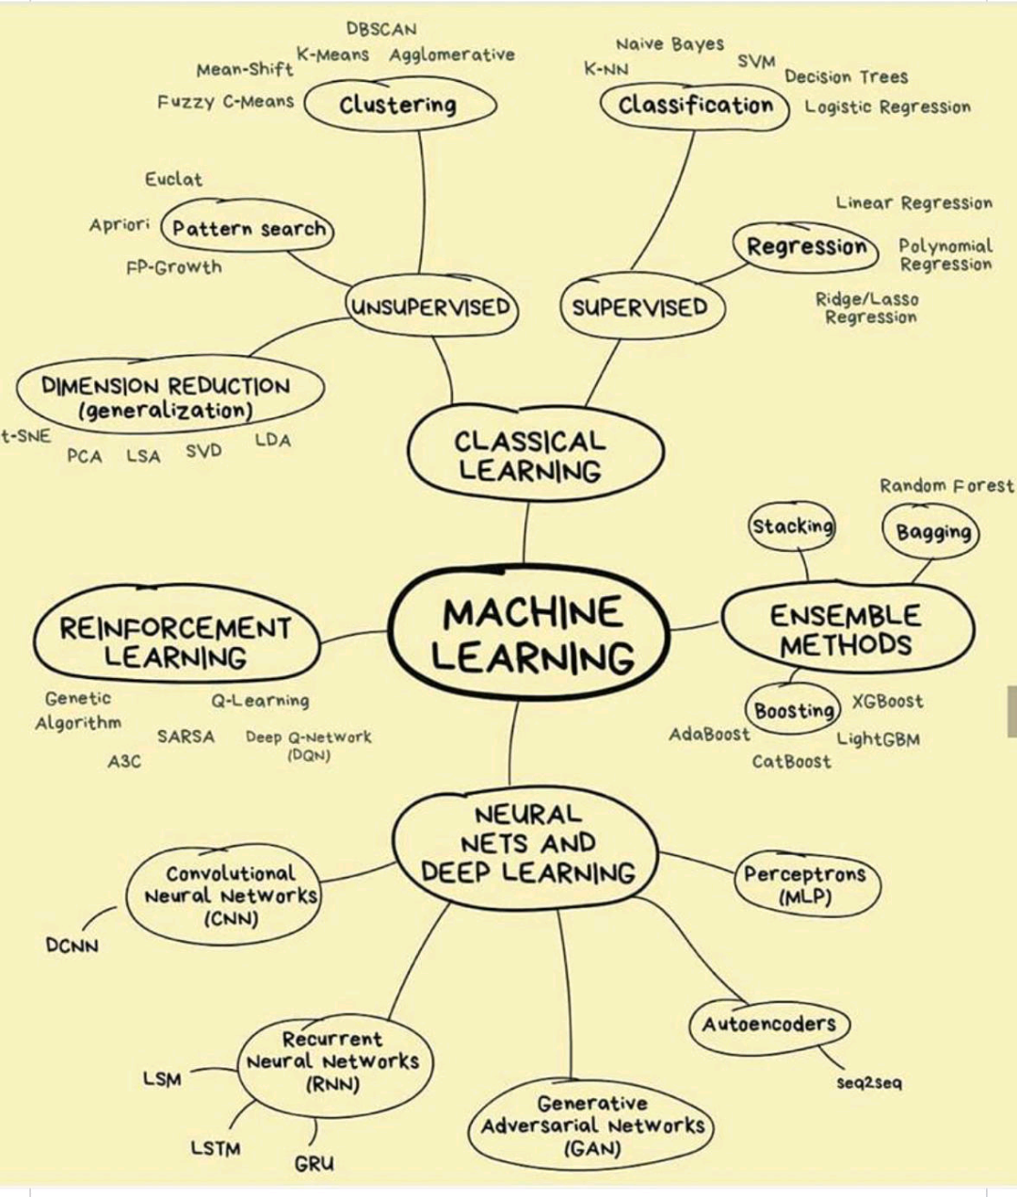

Modeling
Model selection is the process
of choosing one of the models
as the final model that
addresses the problem.

Slide 9
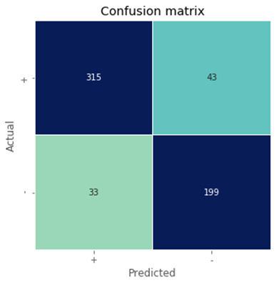

How well your model performs?
Example: Classification problem
The number of correct and incorrect predictions are summarized with count values and broken down by each class. This is the key to the confusion matrix.
It gives us insight not only into the errors being made by a classifier but more importantly the types of errors that are being made.

Slide 10
Thank you

